Slide 1
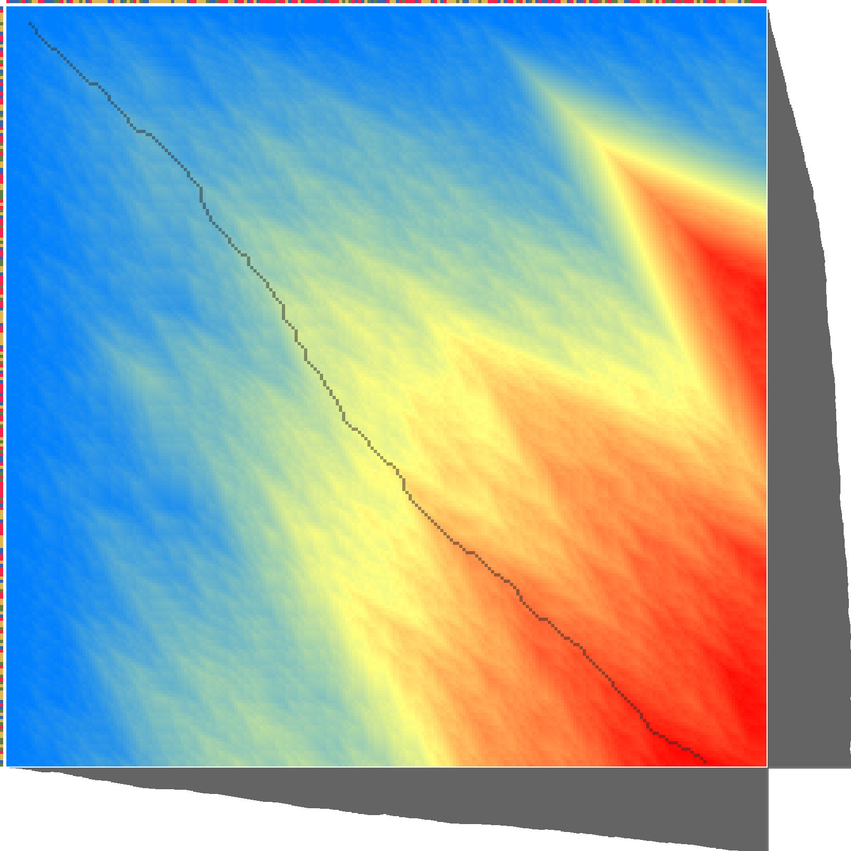
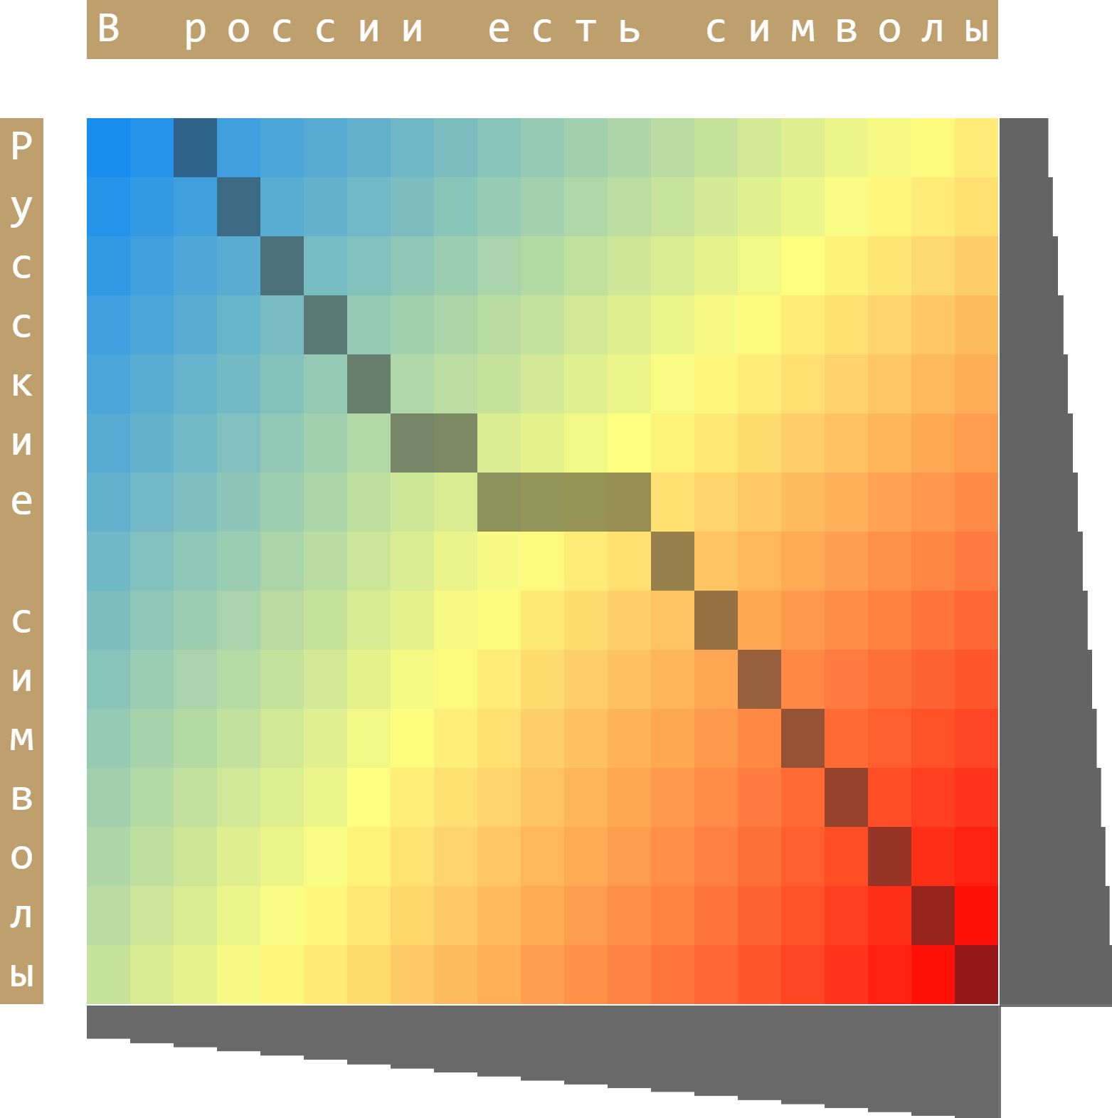
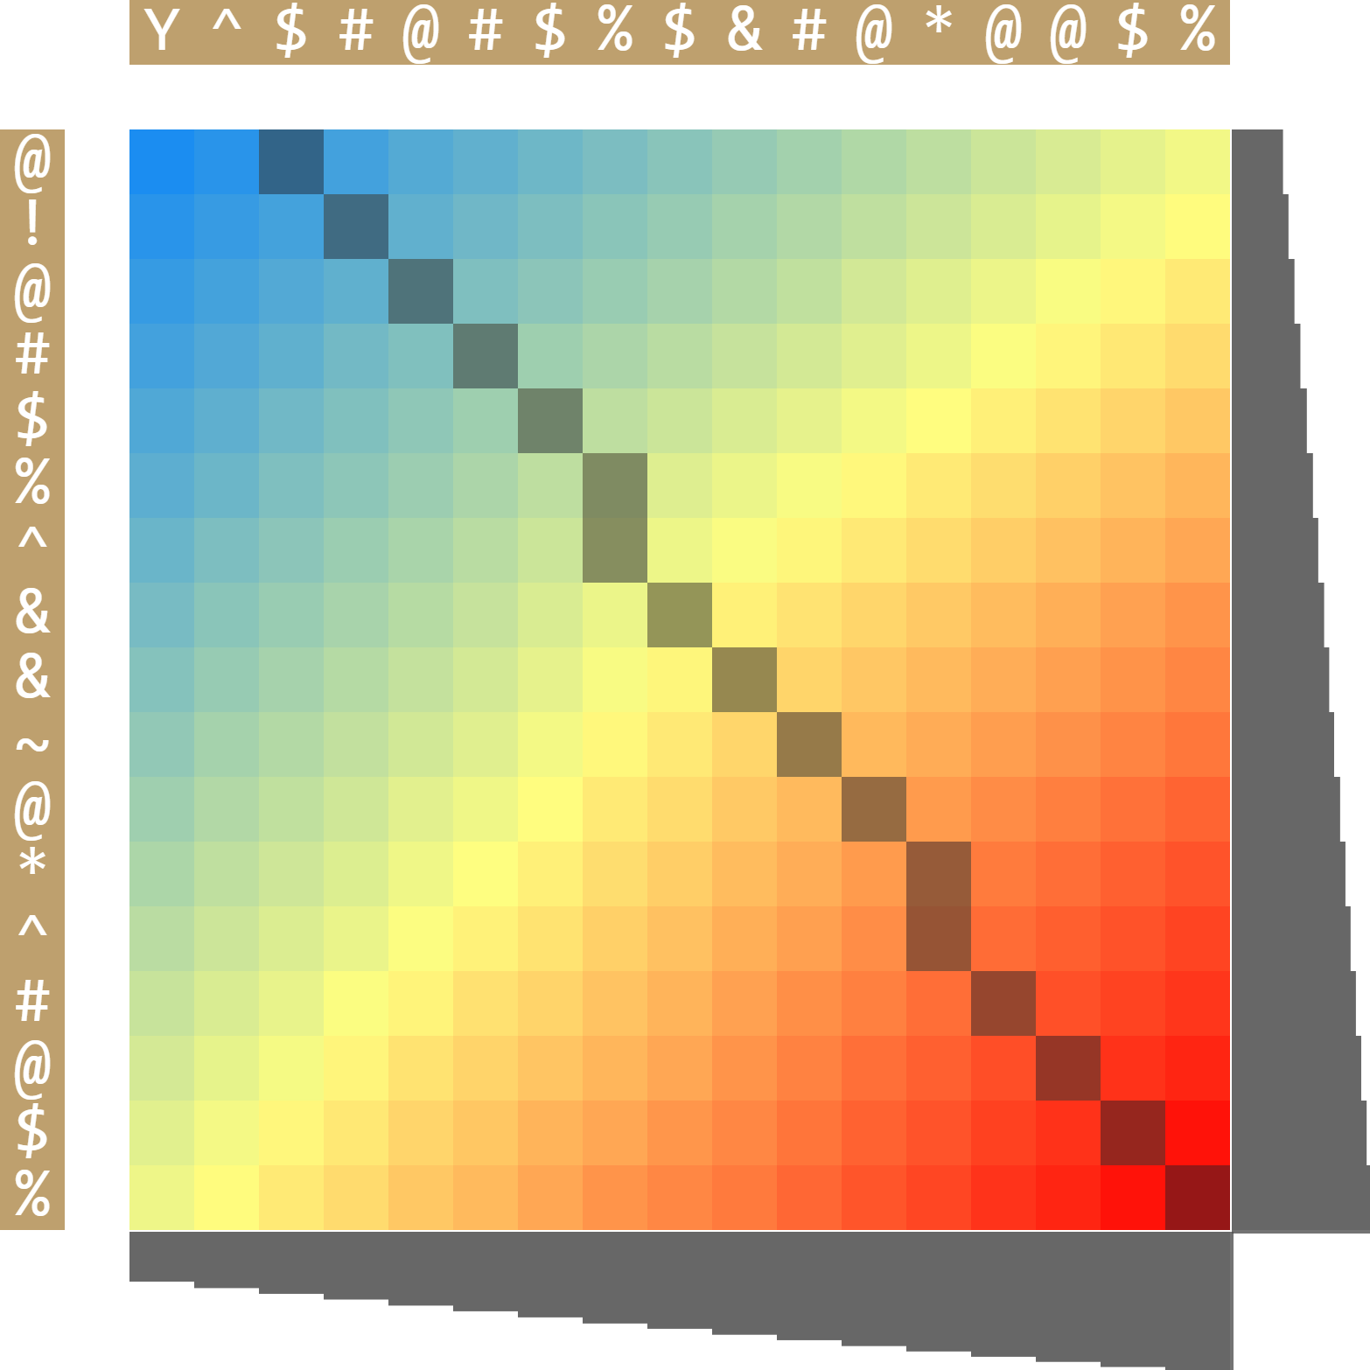
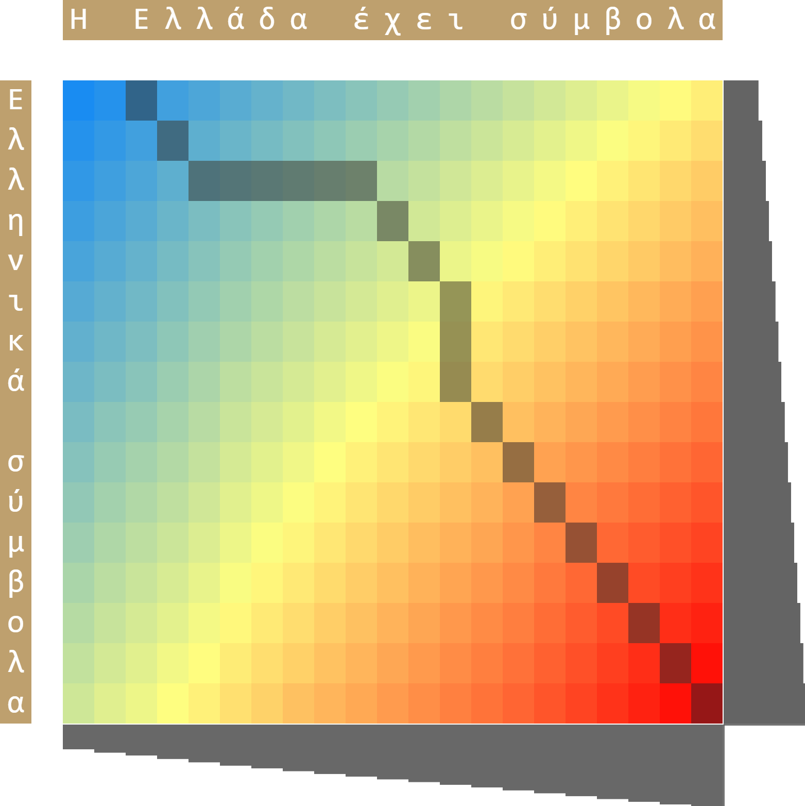
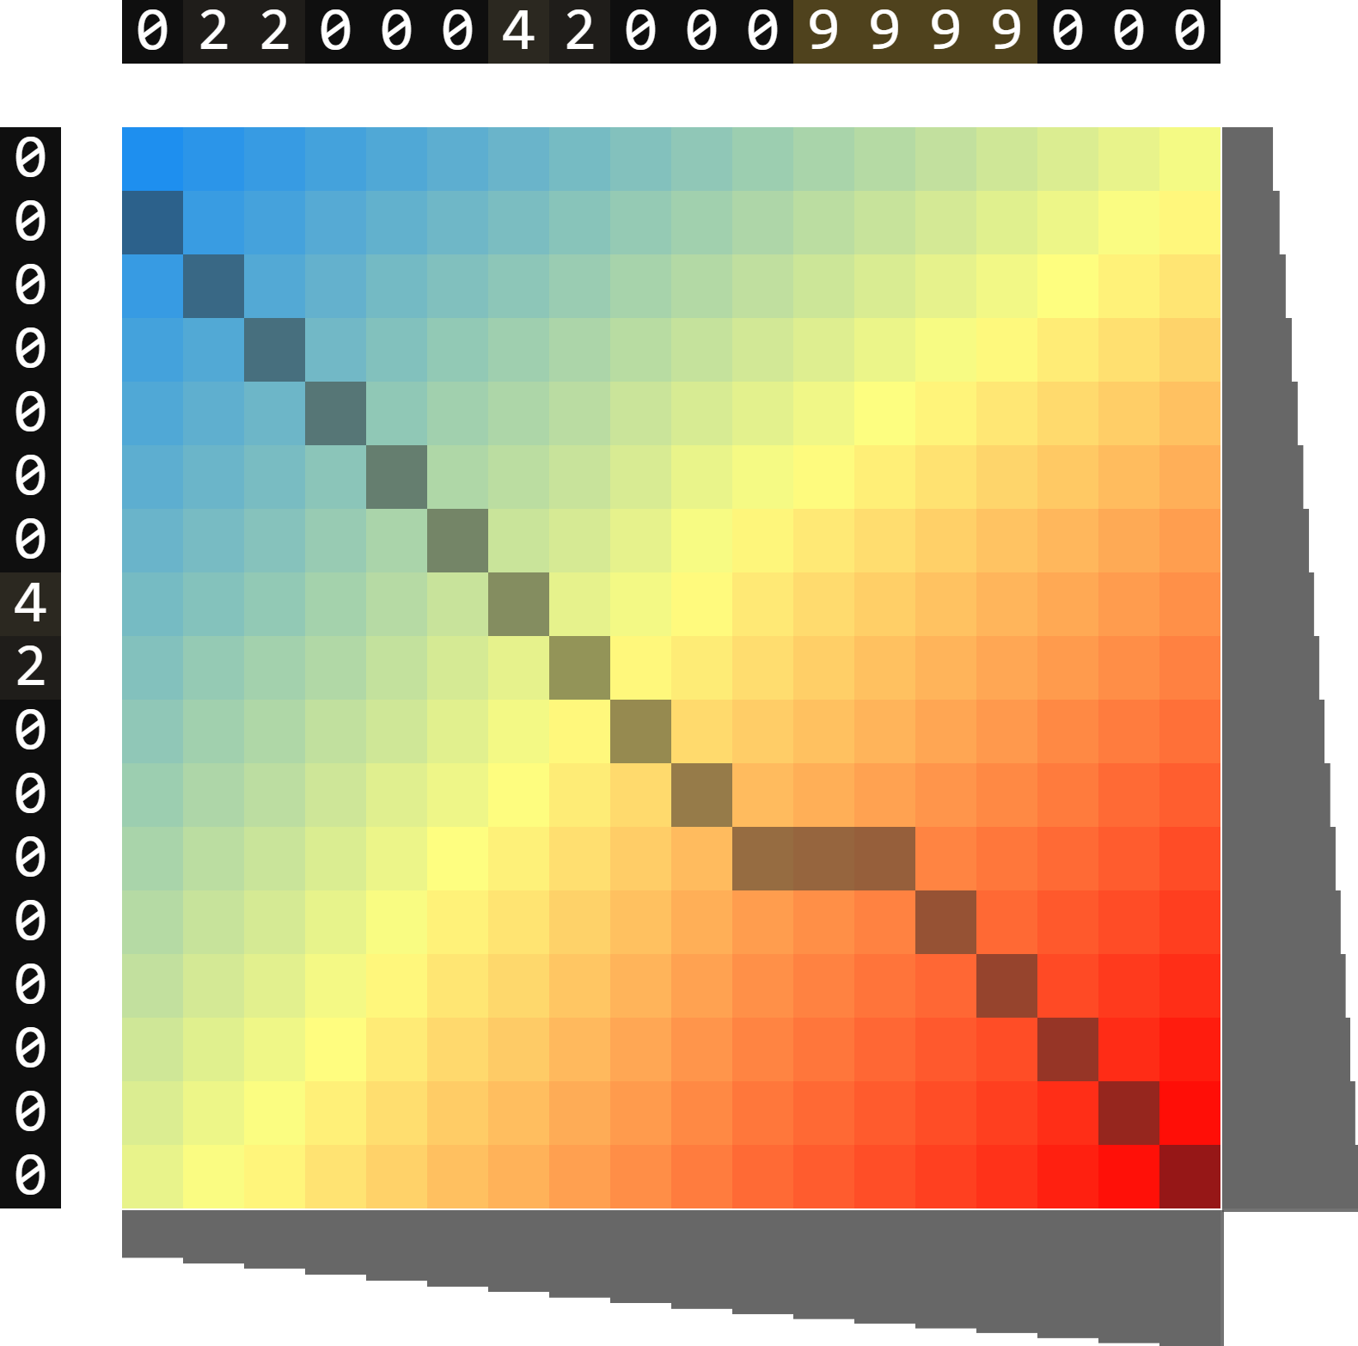
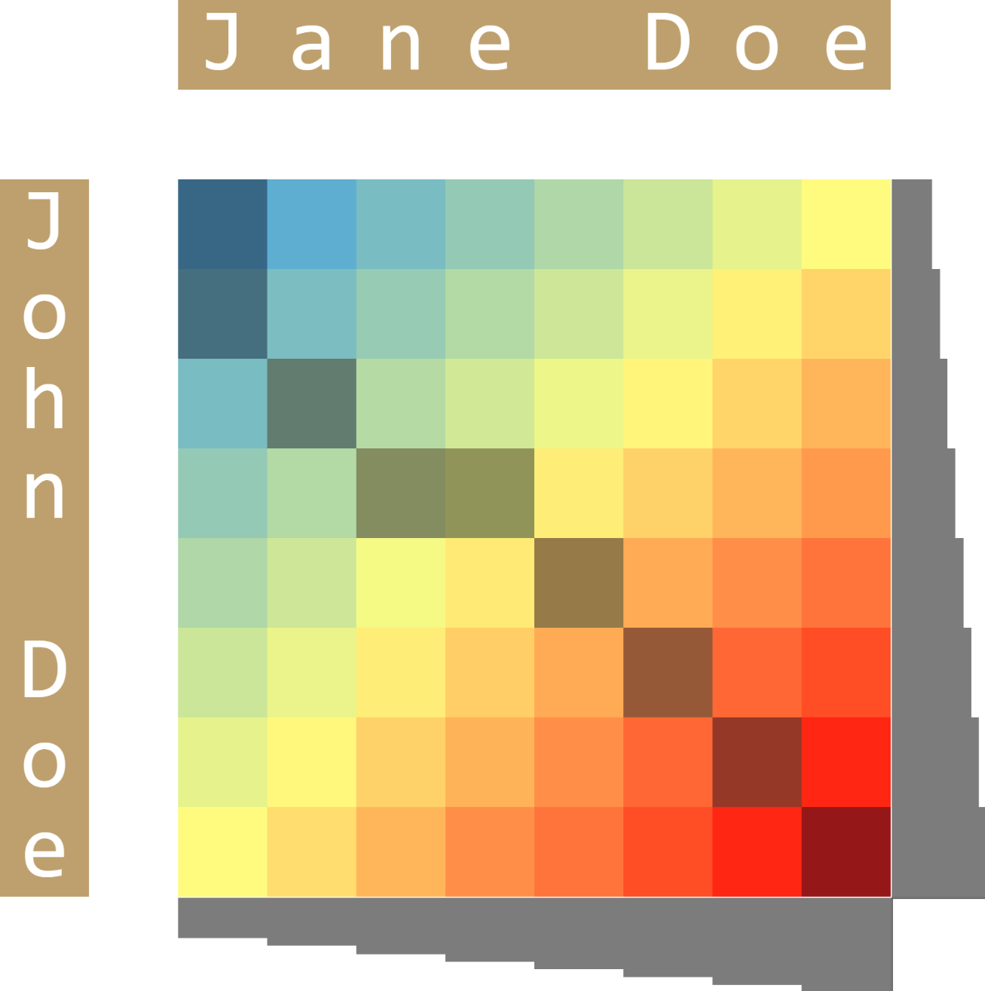
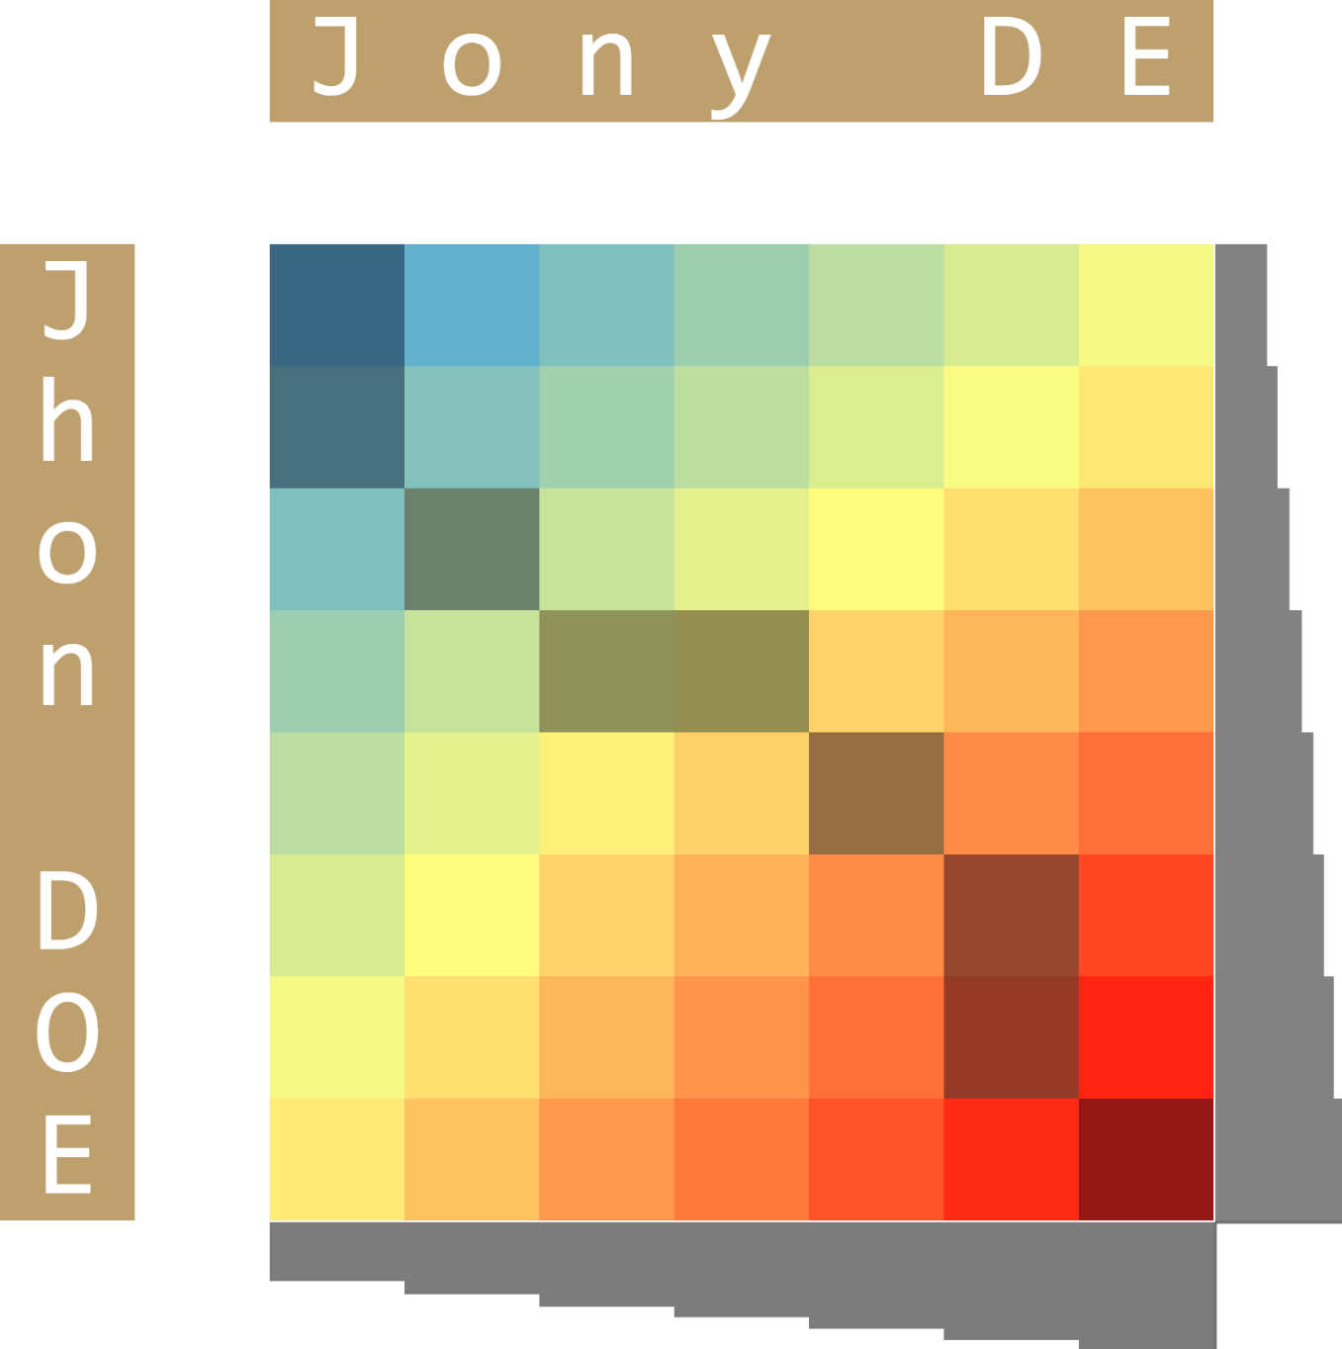
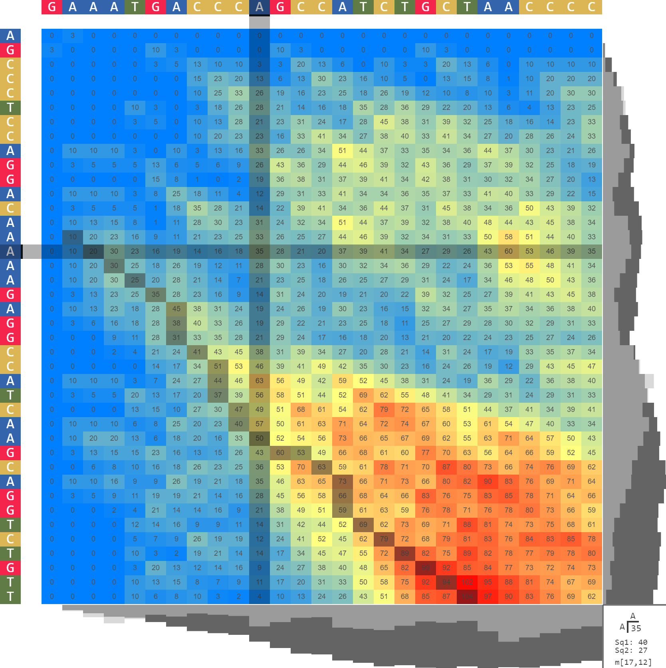
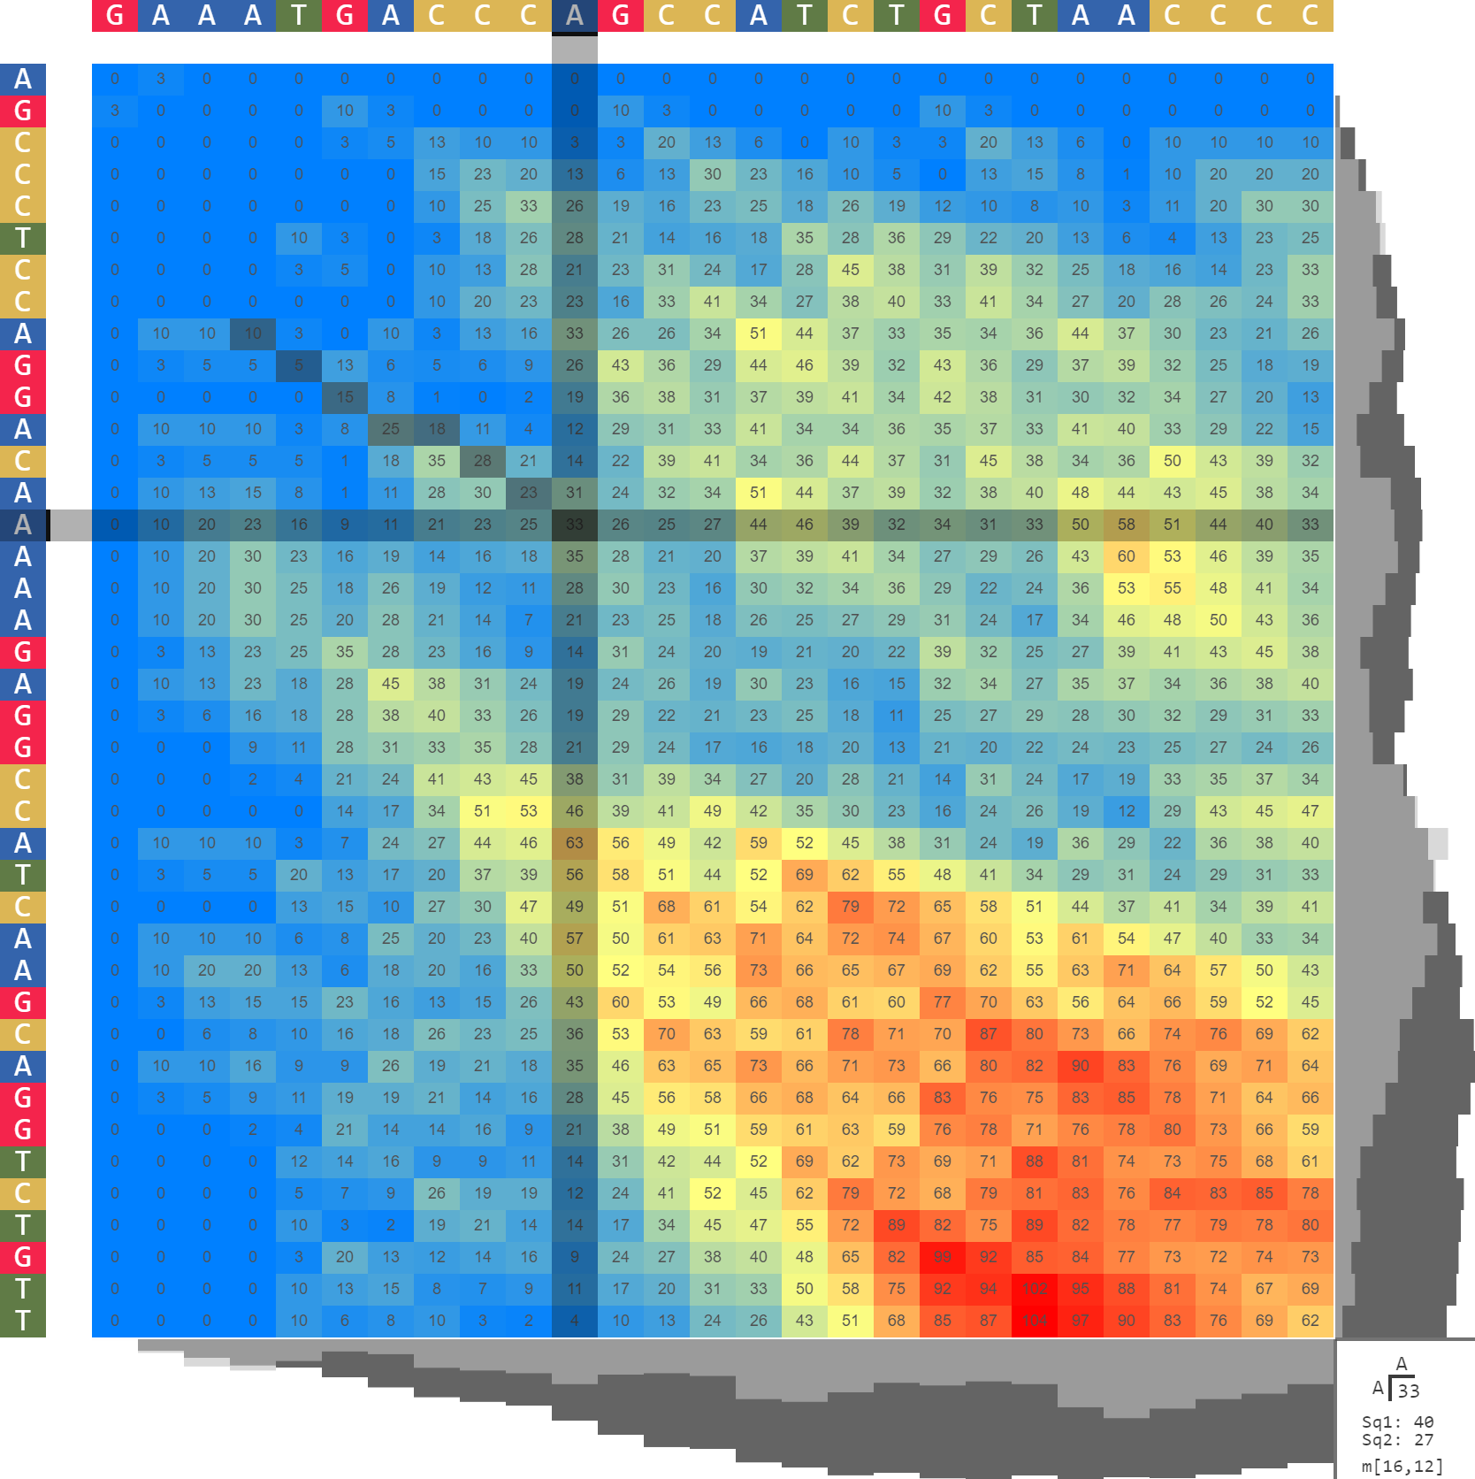
(b)
(c)
significant alignment
best alignment
[──Русски─е─── символы]
██ █ █ ████████
[В россии есть символы]
[──@!@#$%^&&~@*^#@$%]
████ █ ██ ███
[Y^$#@#$%─$&#@*─@@$%]
(a)
(d)
(e)
[John─ Doe] █ █ ████ [J─ane Doe]
(f)
[Jhon─ DOE]
█ ██ ██ █
[J─ony D─E]
[──Ελλ─────ηνικά σύμβολα]
███ █ ████████
[Η Ελλάδα έχει── σύμβολα]
[000000042000──00000]
█ ████████ ███
[─022000420009999000]
┏ 40b
AGCCCTCCAGGACAAAAAGAGGCCATCAAG─CAGGTCTGTT
███ ██ ██ █ ██ ██ ████ █
GAAATGA──CC──C─AGCCA──TCTGCTAACCCC
┗ 21b
┏ 15b
AGCCCTCCAGGA─CAAAAAGAGGCCATCAAGCAGGTCTGTT
█ ██ █ █
GAAATGACCCAGCCATCTGCTAACCCC
┗ 11b
(g)
(h)

Slide 2


Local alignment regime and symbols
Local alignment regime and symbols. (a) A higher resolution of the heatmap, based on an alignment of the first 300b from of the insulin (INS) gene from Homo sapiens and Macaca mulatta. The heatmap shows that the optimal alignment area does not follow the main diagonal. In this specific case the optimal alignment can be made by changing the traceback location from the element with the maximum value to one of the elements at the base of the top right spike. (b-e) Indicates the possibility of using any symbols outside the English alphabet. (b) shows an alignment based on Cyrillic letters, (c) shows an alignment based on Greek letters (d) shows an alignment based on special characters (e) shows the alignment of digits. (f) shows the alignment of two names and demonstrates a semi-global alignment achieved by the local alignment algorithm. (g,h) It shows the forced sequence alignment regime which consists of changing the traceback from one initial cell to another arbitrary cell. The alignment results are presented above the heatmaps. The regime change leads to different alignment configurations. Notice that the markers above or below each sequence correspond to the position of the cross marker over the heatmap, and the aligned sequences are positioned relative to each other.
Cite this work as:
Paul A. Gagniuc. Algorithms in Bioinformatics: Theory and Implementation. John Wiley & Sons, Hoboken, NJ, USA, 2021, ISBN: 9781119697961.

